Slide 1
Improving Southwest Airlines Customer Service
Building a text analytics model to automatically classify customer inquiries on Twitter
Notes:
Hi everyone, we are group 7 and our project is all about improving Southwest Airline’s customer service operations on Twitter by using text analytics.

Slide 2
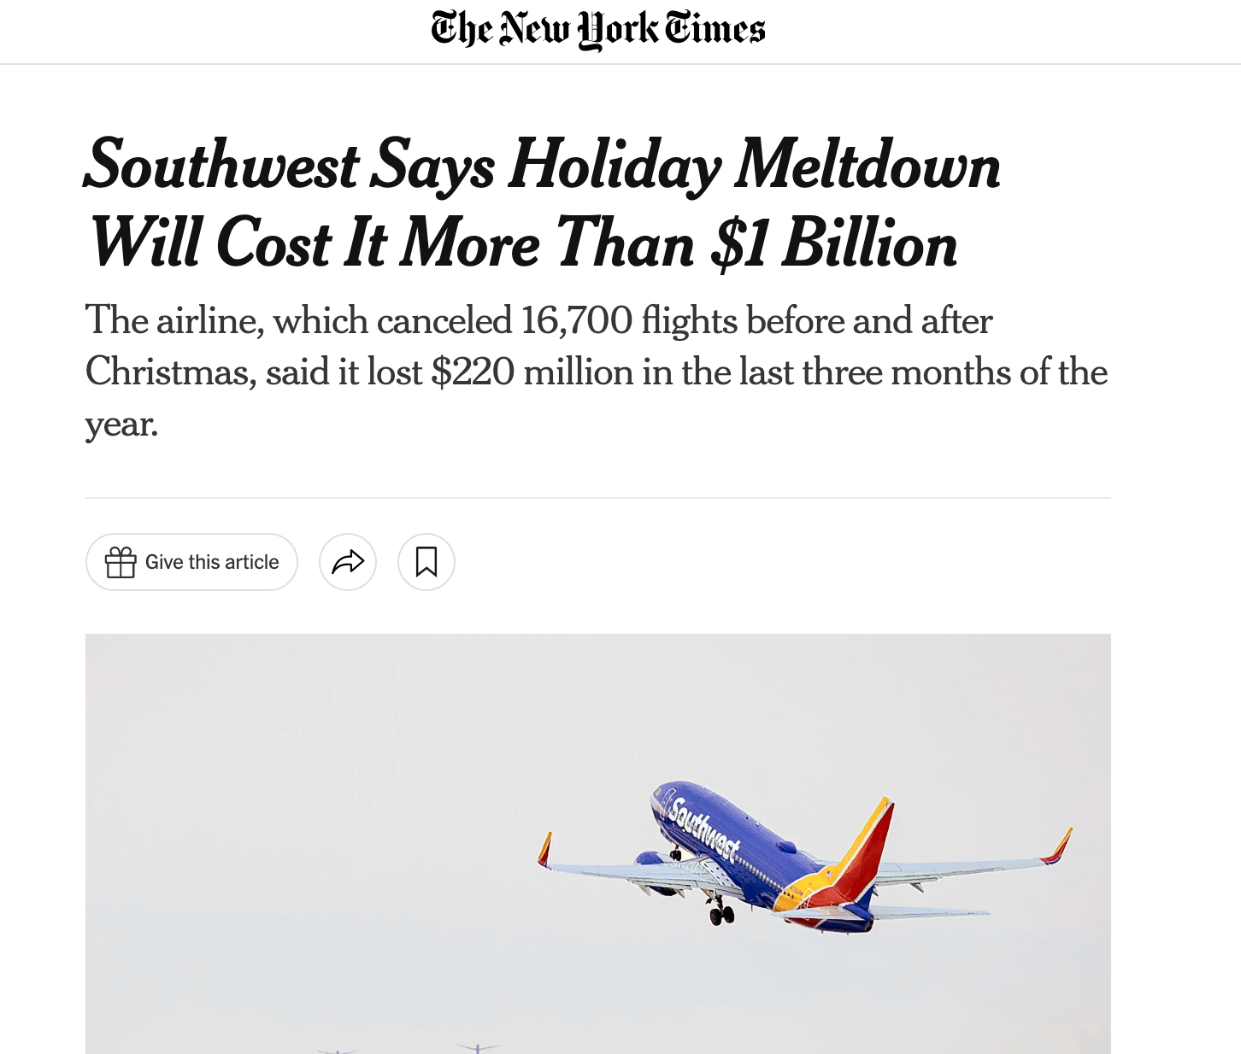
Problem Statement
Southwest Airline received large volume of customer inquiries due to their system breakdown in Dec 2022
Not responded to customers’ inquiries effectively resulted in poor customer experience and loss of business and trust
Photo by Pexels
Notes:
Problem Statement:
Last December, Southwest Airline had to cancel all the flights due to the system breakdown and received a large volume of customer inquiries on Twitter. Not responded to these inquiries efficiently led to a poor customer experience and loss of business. We would like to solve this business problem by building a model that can automatically classify customer inquiries based on topic.

Slide 3


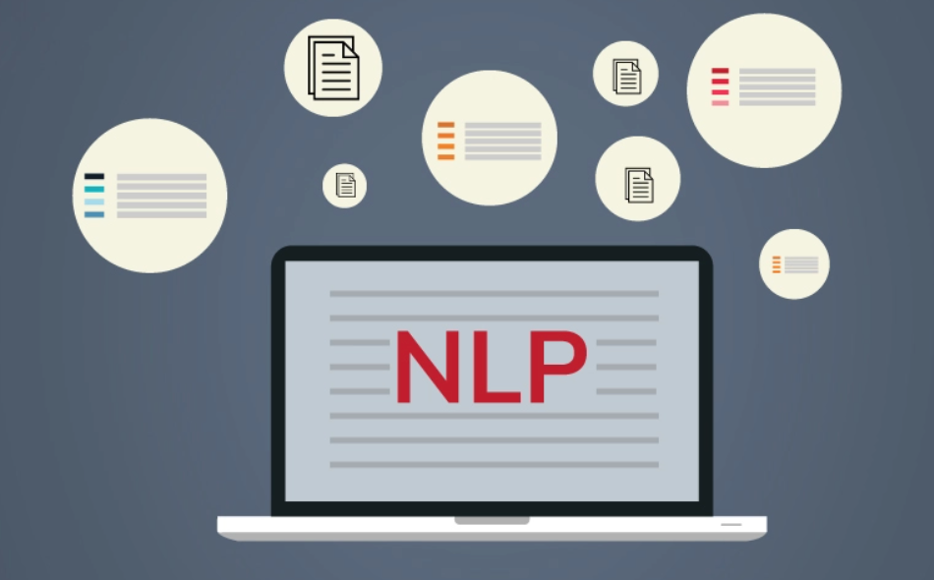
Business Goal Analysis
Respond Needed
Flight Changes & Cancellation
Rapid Rewards Help
Refund Request & Status Help
etc…
Customer’s inquiry
Social Media Team
No Response Needed
Response Needed
Cost reduction
Flight Changes & Cancellation
Rapid Rewards Help
Refund Request & Status Help
etc…
Customer’s inquiry
No Response Needed
Notes:
The business goal is to automatically classify the customer inquiries and achieve possible cost reduction by reducing social media team’s workload.

Slide 4

Data Description
Approx. 3000 tweets collected by scraping Twitter using the Twitter API with a @SouthwestAir ‘tag’
Jan 2023 - Feb 2023
Stored in a CSV file
Comprised of tweets pertaining to
Customer inquiries
Positive and negative reviews
Notes:
Data Description:
The data for this project was collected by scraping Twitter using the Twitter API and approximately 3000 tweets were scraped and stored in a CSV file with information such as the tweet text, user ID, timestamp, retweets and likes.
All the tweets consist of customer inquiries as well as positive and negative reviews. What we aim to achieve is to create a model that can distinguish whether a tweet ultimately requires a response or not.

Slide 5
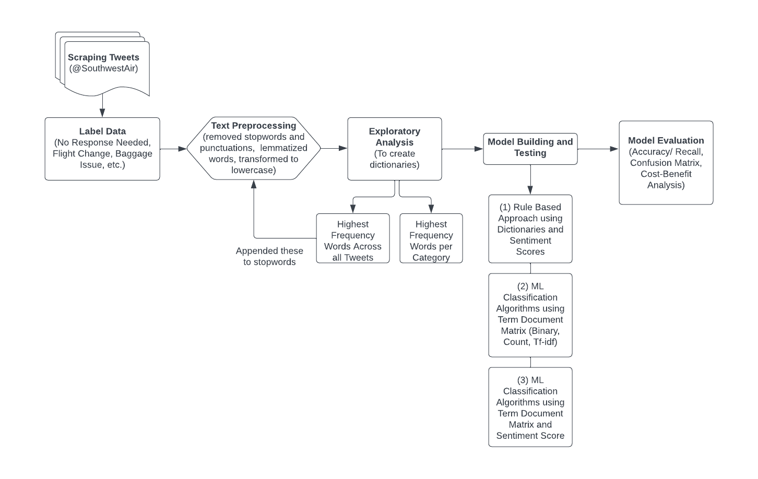
System Design
Notes:
To acheive this task, we undertook the following steps:
Scraping tweets, labelling the data as a team, text preprocessing, an exploratory analysis to build our dictionaries and create stopwords relating to SW air tweets, model building and testing – where we tried out 3 diff methods (rule based, normal ml classification method using term doc matrix, and ml classification methods with an added sentiment score feature). After building all these models, we proceeded to decide on the best model by comparing the accuracies, confusion matrices and cost-benefit analysis results.

Slide 6
System Implementation: Extraction to Preprocessing
/Data Extraction: Python
Web Scraping to Extract Tweets from Twitter API
/Annotation: Excel
Manually Categorize Tweets into 8 Classes
/Text Pre-Processing: Python
Flight Changes & Cancellation
Rapid Rewards Help
Refund Request & Status Help
Others - help needed
Baggage Help
Seats Help
Covid 19
No Response Needed
Exploratory Analysis
Exploratory Analysis
Sentiment Analysis
/Top 30 Frequent Words
/Top 30 Frequent Nouns
Stopwords Elimination
Special Character Elimination
Frequent Words Elimination
Tokenization
Lemmatization
Stopwords Elimination
Special Character Elimination
Frequent Words Elimination
Tokenization
Special Character Elimination
Adding “?” Back to Text
Tokenization

Slide 7
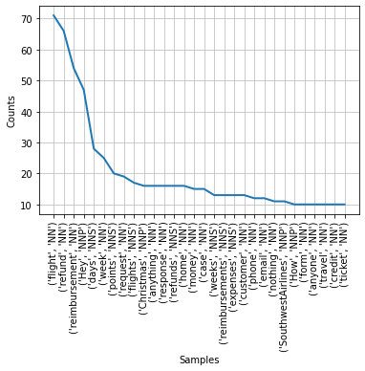
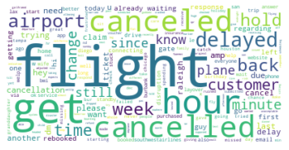
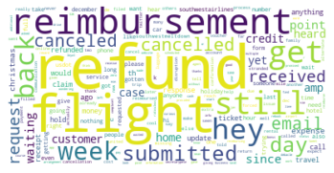
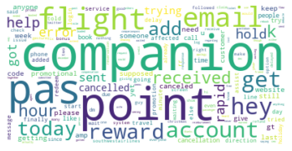
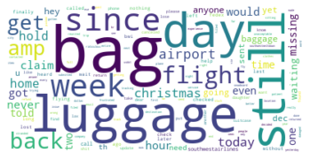
System Implementation: Exploratory Analysis and Dictionary Building
/Exploratory Data Analysis: Python

Slide 8
System Implementation: Method 1 (Rule-Based Approach)
{"luggage", "bag", "baggage", "suitcase", "bags"}
{"find", "lost", "lose", "missing", "damaged", "tracking"}
Baggage Help = luggage_related AND baggage_issues
Response Needed
Score < -5
Dictionary Approach
Rule Based Sentiment Analysis +
Binary Classification with Dictionary
Afinn
No Response Needed
No Response Needed
Score >= -5

Slide 9
System Implementation: Methods 2 (Term Document Matrix)
and Method 3 (Term Document Matrix + Sentiment Score)
Method2:
Feature Engineering + Machine Learning
Method3:
Feature Engineering + Machine Learning
+ Sentiment Score
Sentiment
Score
Bag of Words - Binary
Bag of Words - Frequency
Tf-idf
Bag of Words - Binary
Bag of Words - Frequency
Tf-idf
Naive Bayes
Decision Tree
Random Forest
Naive Bayes
Decision Tree
Random Forest
Logistic Regression
SVM
XGBoost
Logistic Regression
SVM
XGBoost

Slide 10
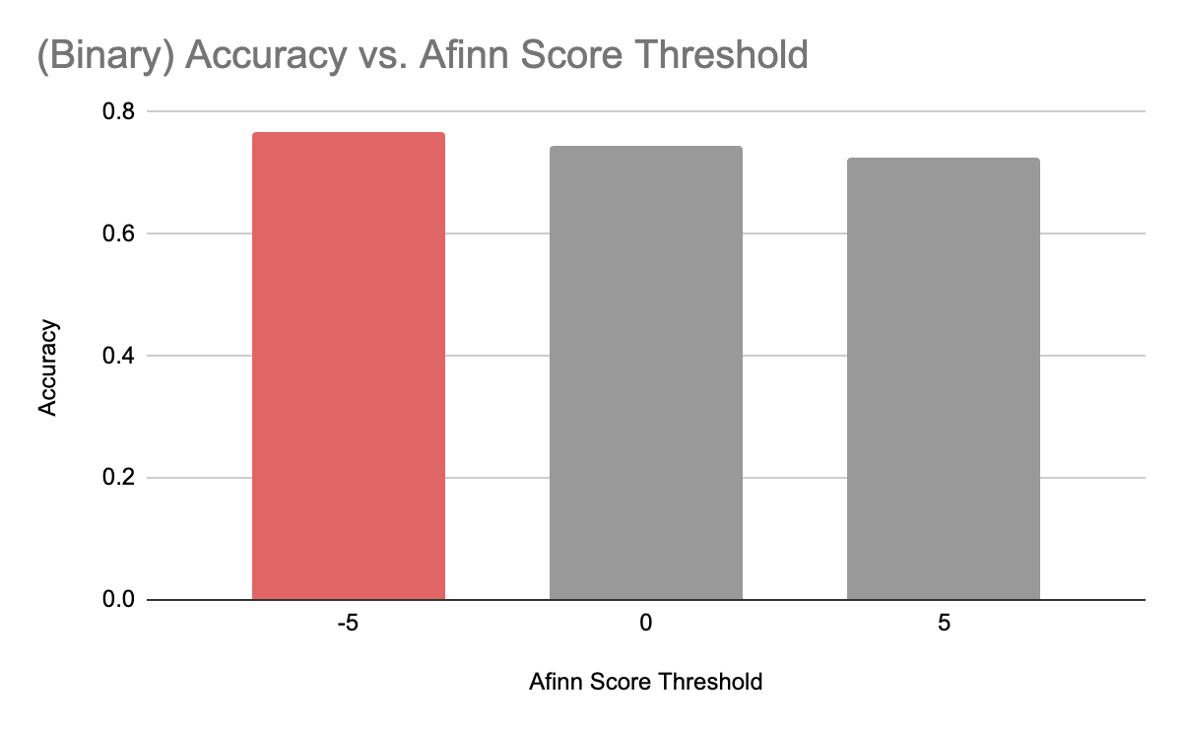
Method 1 (Sentiment Analysis with Dictionary Approach) :
Notes:
For Method 1, we tested out different threshold for sentiment analysis and confirmed that -5 achieves the best accuracy of 0.767. This imply that most tweets where no response needed have greater than -5.

Slide 11
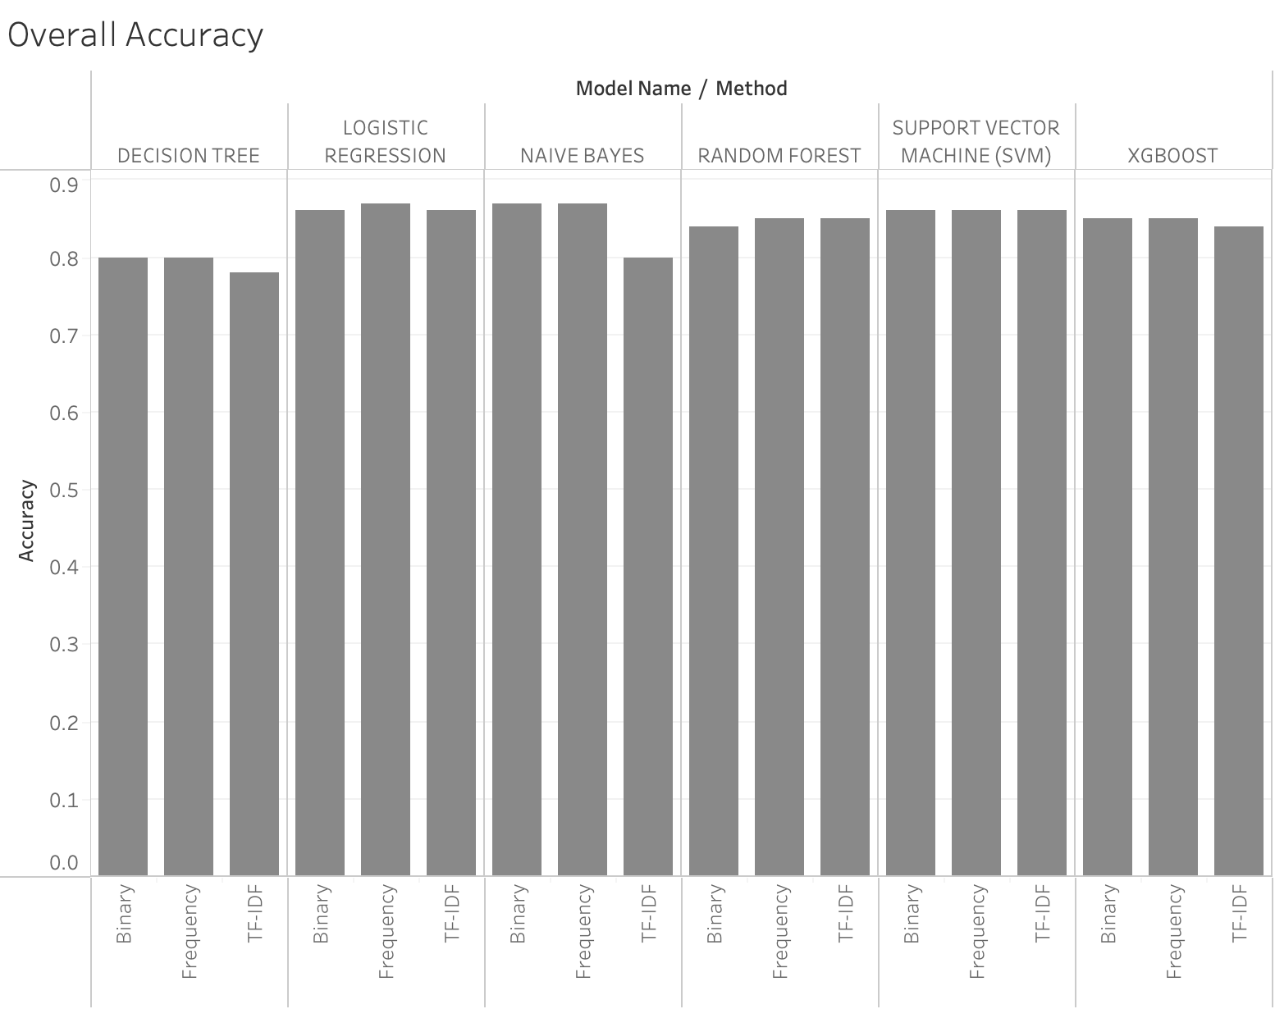
Methods 2 (Term Document Matrix) :
0.866
0.871
Notes:
For the method 2, we ran 6 machine learning models with three different term representation methods and confirmed that Naïve Bayes with Frequency method performed the best.

Slide 12
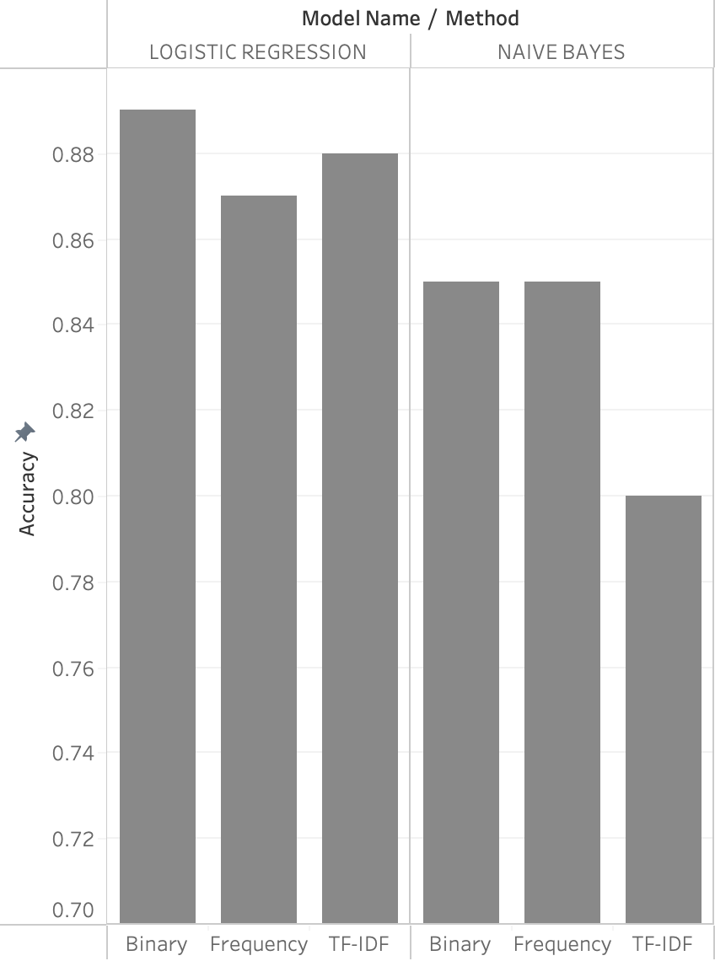
Methods 3 (Method 2 + Sentiment Score) :
0.888
Notes:
Lastly, for the method 3, logistic regression with binary method works the best with the accuracy of 0.888

Slide 13
Conclusion & Findings :
Our logistic regression model with term document matrix and sentiment score features outperformed the other two methods
Relying solely on keywords is not sufficient for accurately classifying customer inquiries.
Customizing the text pre-processing steps based on the chosen text analytics approach is important for text analytics project
The urgency of ticket inquiries can be changed over time, which adds another layer of complexity to the classification task
 | Accuracy
Method1 | 0.767
Method2 | 0.871
Method3 | 0.888
Notes:
As we just demonstrated, our logistic regression model with both term document matrix and sentiment score features, outperformed the other two methods in classifying customer inquiries

Slide 14
Future Direction :
Expanding the model to include multiple classes that represent specific inquiry topics
Incorporating more advanced natural language processing (NLP) techniques such as transformer-based models (e.g. BERT)
Exploring the use of ensemble methods to combine the predictions from multiple models
Using multiple evaluation metrics such as precision, recall, and F1-score, in addition to accuracy

